Slide 1
Mehran S. Fallah March, 2020
Discrete Mathematics
Session 1
Counting: Principles and Concepts

Slide 2
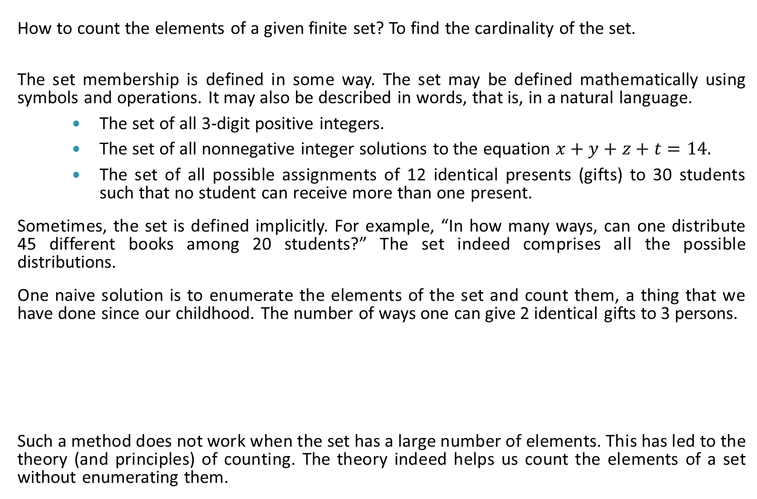
Introduction
How to count the elements of a given finite set? To find the cardinality of the set.
The set membership is defined in some way. The set may be defined mathematically using symbols and operations. It may also be described in words, that is, in a natural language.
The set of all 3-digit positive integers.
The set of all nonnegative integer solutions to the equation $x+y+z+t=14.$
The set of all possible assignments of 12 identical presents (gifts) to 30 students such that no student can receive more than one present.
Sometimes, the set is defined implicitly. For example, “In how many ways, can one distribute 45 different books among 20 students?” The set indeed comprises all the possible distributions.
One naive solution is to enumerate the elements of the set and count them, a thing that we have done since our childhood. The number of ways one can give 2 identical gifts to 3 persons.
Such a method does not work when the set has a large number of elements. This has led to the theory (and principles) of counting. The theory indeed helps us count the elements of a set without enumerating them.
Person
Gifts Assigned
A | B | C
 |  | G G
A | B | C
 | G | G
A | B | C
G |  | G
A | B | C
 | G G
A | B | C
G | G
A | B | C
G G

Slide 3
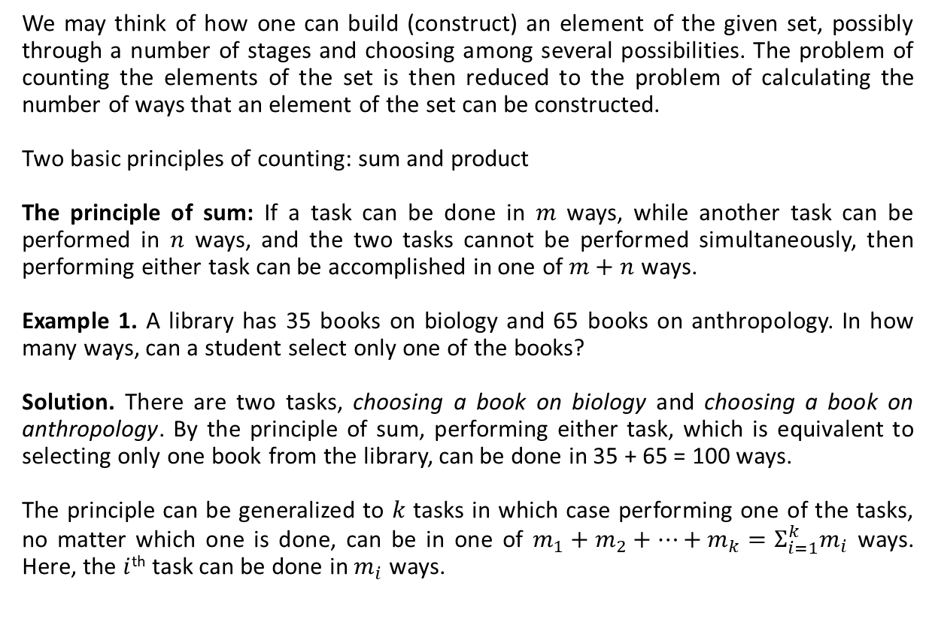
Basic Principles of Counting
We may think of how one can build (construct) an element of the given set, possibly through a number of stages and choosing among several possibilities. The problem of counting the elements of the set is then reduced to the problem of calculating the number of ways that an element of the set can be constructed.
Two basic principles of counting: sum and product
The principle of sum: If a task can be done in $m$ ways, while another task can be performed in $n$ ways, and the two tasks cannot be performed simultaneously, then performing either task can be accomplished in one of $m+n$ ways.
Example 1. A library has 35 books on biology and 65 books on anthropology. In how many ways, can a student select only one of the books?
Solution. There are two tasks, choosing a book on biology and choosing a book on anthropology. By the principle of sum, performing either task, which is equivalent to selecting only one book from the library, can be done in 35 + 65 = 100 ways.
The principle can be generalized to $k$ tasks in which case performing one of the tasks, no matter which one is done, can be in one of $m_{1}+m_{2}+⋯+m_{k}=Σ_{i=1}^{k}m_{i}$ ways. Here, the $i$^{th} task can be done in $m_{i}$ ways.

Slide 4
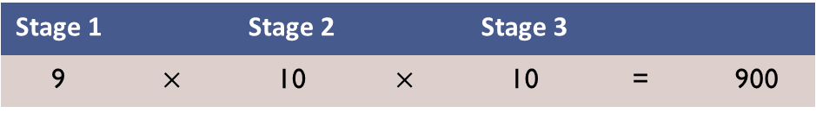
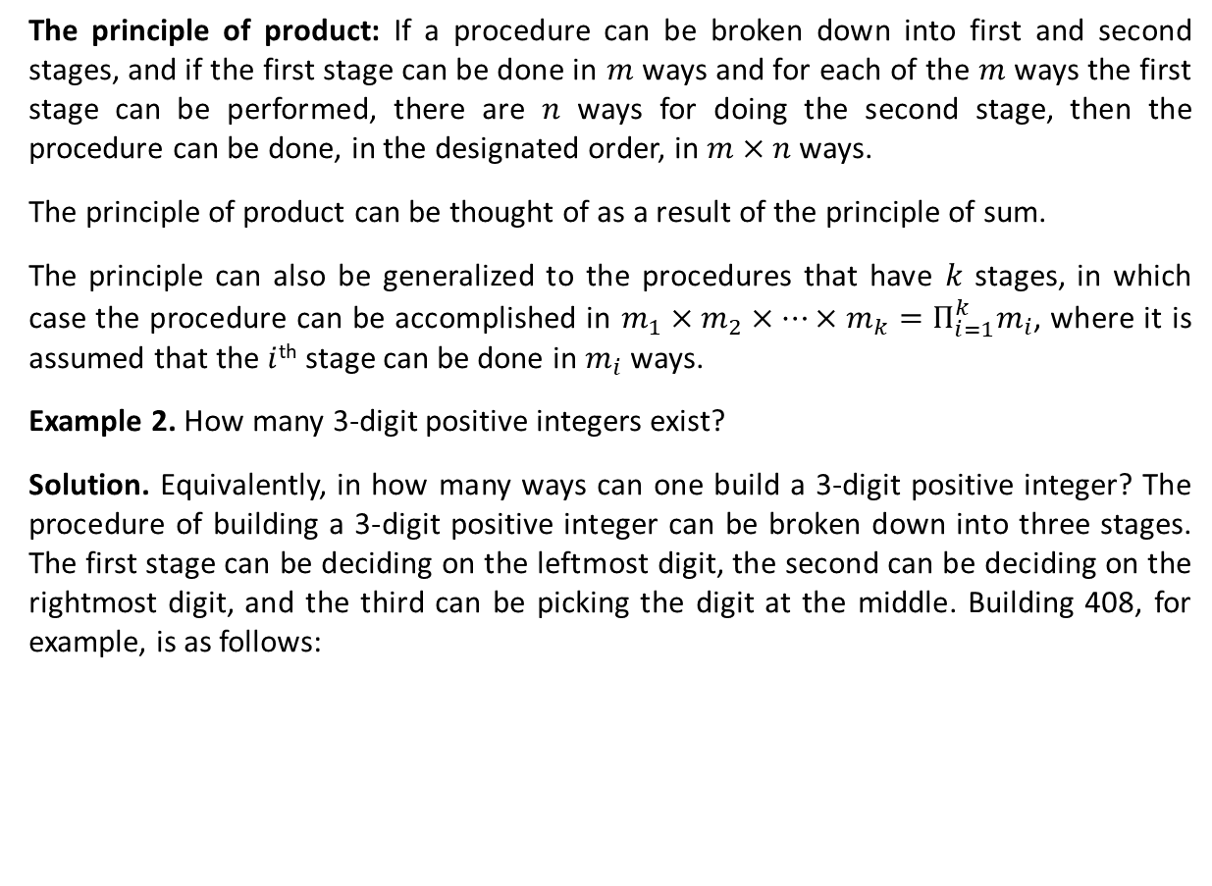
The Principle of Product
The principle of product: If a procedure can be broken down into first and second stages, and if the first stage can be done in $m$ ways and for each of the $m$ ways the first stage can be performed, there are $n$ ways for doing the second stage, then the procedure can be done, in the designated order, in $m×n$ ways.
The principle of product can be thought of as a result of the principle of sum.
The principle can also be generalized to the procedures that have $k$ stages, in which case the procedure can be accomplished in $m_{1}×m_{2}×⋯×m_{k}=Π_{i=1}^{k}m_{i}$, where it is assumed that the $i$^{th} stage can be done in $m_{i}$ ways.
Example 2. How many 3-digit positive integers exist?
Solution. Equivalently, in how many ways can one build a 3-digit positive integer? The procedure of building a 3-digit positive integer can be broken down into three stages. The first stage can be deciding on the leftmost digit, the second can be deciding on the rightmost digit, and the third can be picking the digit at the middle. Building 408, for example, is as follows:
4
0
8
Stage 1 |  | Stage 2 |  | Stage 3
9 | $$×$$ | 10 | $$×$$ | 10 | = | 900

Slide 5
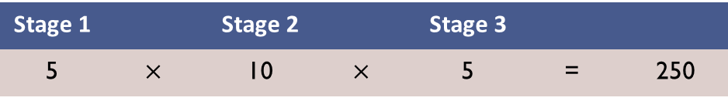
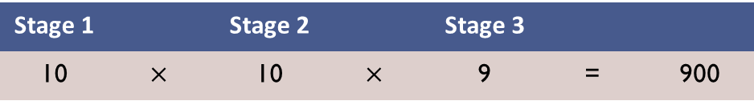
The Principle of Product (Ctd.)
The first stage can be deciding on the units digit, the second can be deciding on the tens digit, and the third can be picking the hundreds digit. Stages of building 408 is thus as follows:
Example 3. Find The number of 3-digit positive even integers that are less than 600.
Solution. The first, second, and third stages could be deciding on the hundreds, tens, and units digits, respectively.
Sometimes, the choice of stages is quite relevant; the use of the principle of product may otherwise be impossible. Note that according to the principle, for every way the first stage is accomplished, there must be the same number of ways for the second stage. This may require us to employ the principles of sum and product in concert.
4
0
8
Stage 1 |  | Stage 2 |  | Stage 3
10 | $$×$$ | 10 | $$×$$ | 9 | = | 900
Stage 1 |  | Stage 2 |  | Stage 3
5 | $$×$$ | 10 | $$×$$ | 5 | = | 250

Slide 6
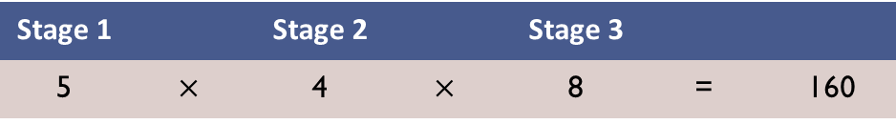
Using the Principles Together
Example 4. Find the number of 3-digit positive odd integers that are less than 600 and there is no repeated digit in the number.
Solution Assume that the first stage is deciding on the hundreds digit and the second is choosing the units digit. One of the ways for doing the first stage is choosing 3, for example. If we decide on 3 as the hundreds digit of the number, the second stage can be done in 4 ways (we cannot use 3, and thus, there remains 4 choices, 1, 5, 7, and 9.) On the other hand, if the hundreds digit is 2, the second stage can be done in 5 ways (we can choose any of 1, 3, 5, 7, and 9.) Thus, stages as above renders the use of the principle of product impossible.
Another choice of stages may be as follows: the first stage is deciding on the units digit, the second on the hundreds digit, and the third on the tens digit.
This does not work either. If we choose digit 9 in the first stage, we have 5 ways for doing the second stage, while it is 4 ways if we choose 3 in the first stage.
Stage 1 |  | Stage 2 |  | Stage 3
5 | $$×$$ | 4 | $$×$$ | 8 | = | 160

Slide 7
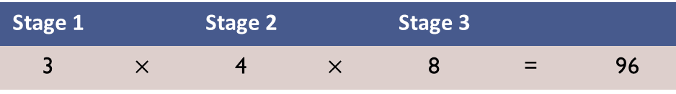
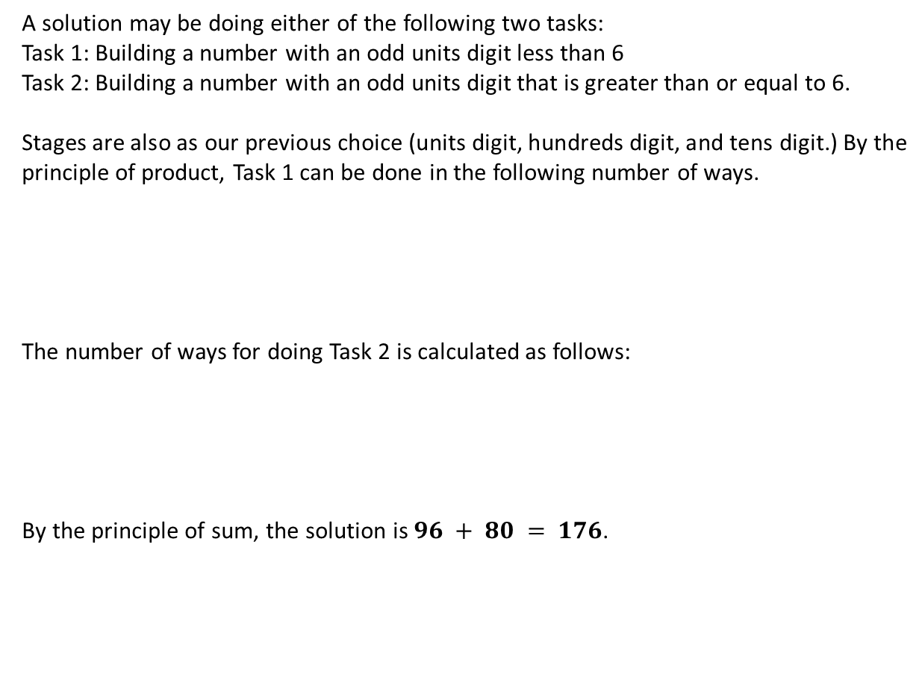
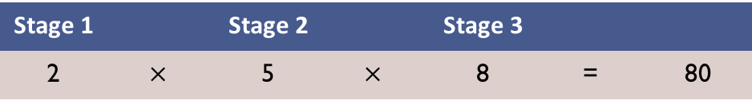
Using the Principles Together (Ctd.)
A solution may be doing either of the following two tasks:
Task 1: Building a number with an odd units digit less than 6
Task 2: Building a number with an odd units digit that is greater than or equal to 6.
Stages are also as our previous choice (units digit, hundreds digit, and tens digit.) By the principle of product, Task 1 can be done in the following number of ways.
The number of ways for doing Task 2 is calculated as follows:
By the principle of sum, the solution is $96 + 80 = 176$.
Stage 1 |  | Stage 2 |  | Stage 3
3 | $$×$$ | 4 | $$×$$ | 8 | = | 96
Stage 1 |  | Stage 2 |  | Stage 3
2 | $$×$$ | 5 | $$×$$ | 8 | = | 80

Slide 8
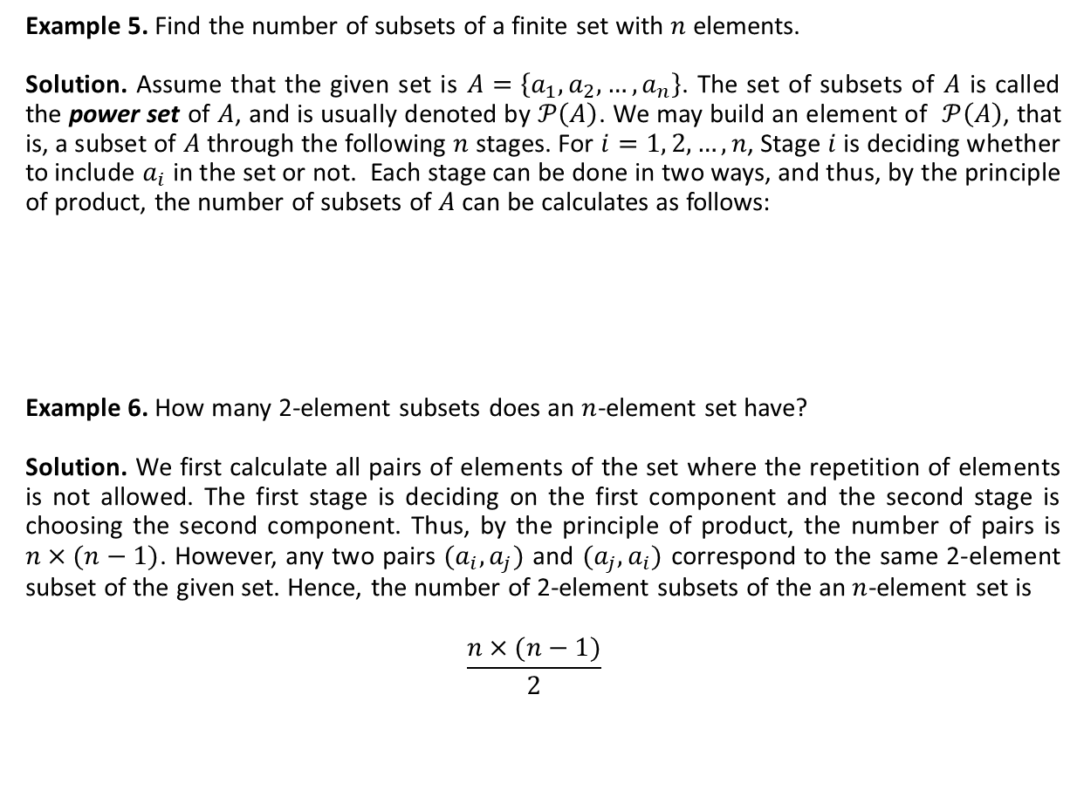
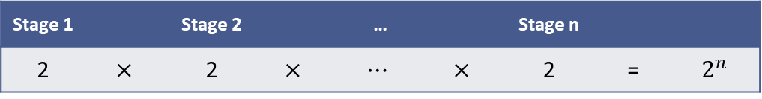
Some Examples
Example 5. Find the number of subsets of a finite set with $n$ elements.
Solution. Assume that the given set is $A=\left\{a_{1},a_{2}, …, a_{n}\right\}$. The set of subsets of $A$ is called the power set of $A$, and is usually denoted by $𝒫\left(A\right)$. We may build an element of $𝒫\left(A\right)$, that is, a subset of $A$ through the following $n$ stages. For $i=1, 2, …, n$, Stage $i$ is deciding whether to include $a_{i}$ in the set or not. Each stage can be done in two ways, and thus, by the principle of product, the number of subsets of $A$can be calculates as follows:
Example 6. How many 2-element subsets does an $n$-element set have?
Solution. We first calculate all pairs of elements of the set where the repetition of elements is not allowed. The first stage is deciding on the first component and the second stage is choosing the second component. Thus, by the principle of product, the number of pairs is $n×(n−1)$. However, any two pairs $(a_{i}, a_{j})$ and $(a_{j}, a_{i})$ correspond to the same 2-element subset of the given set. Hence, the number of 2-element subsets of the an $n$-element set is
$$\frac{n×(n−1)}{2}$$
Stage 1 |  | Stage 2 |  | … |  | Stage n
2 | $$×$$ | 2 | $$×$$ | $$⋯$$ | $$×$$ | 2 | = | $$2^{n}$$

Slide 9
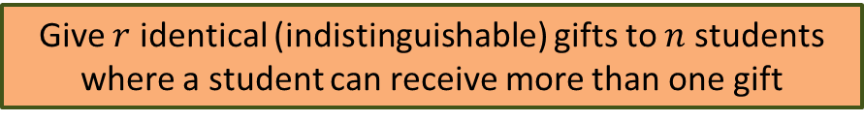
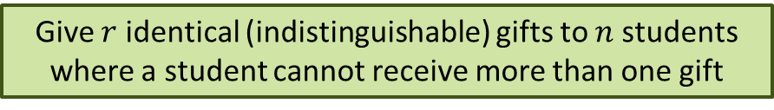
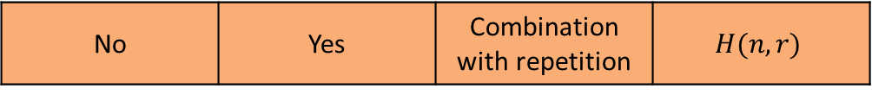
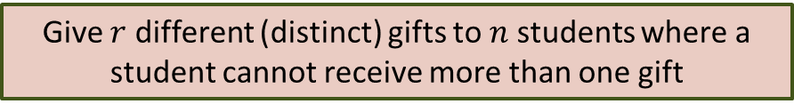
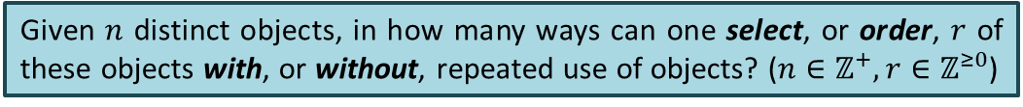
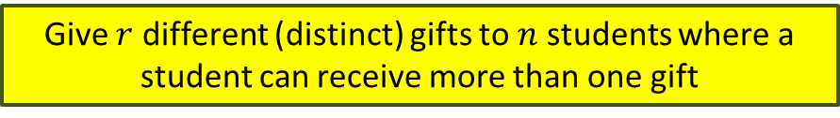
A General Counting Problem
We can employ the principles of sum and product to solve counting problems. However, it is quite useful to identify some classes of the problem and formulate a general solution for instances of each class. The following is a general counting problem.
We can identify four classes of problems: … select … with …, … select … without …, … order … with …, and … order … without. These classes are summarized in the following table.
Given $n$ distinct objects, in how many ways can one select, or order, $r$ of these objects with, or without, repeated use of objects? ($n∈ℤ^{+},r∈ℤ^{≥0}$)
Give $r$ different (distinct) gifts to $n$ students where a student can receive more than one gift
Give $r$ identical (indistinguishable) gifts to $n$ students where a student cannot receive more than one gift
Give $r$ different (distinct) gifts to $n$ students where a student cannot receive more than one gift
Give $r$ identical (indistinguishable) gifts to $n$ students where a student can receive more than one gift
Order Is Relevant | Repetitions Are Allowed | Class of the Problem | Notation
Yes | Yes | Arrangement | $$A(n,r)$$
Yes | No | Permutation | $$P(n,r)$$
No | No | Combination | $C(n,r)$ or $\left(\begin{matrix}n \\ r\end{matrix}\right)$
No | Yes | Combination with repetition | $$H(n,r)$$

Slide 10

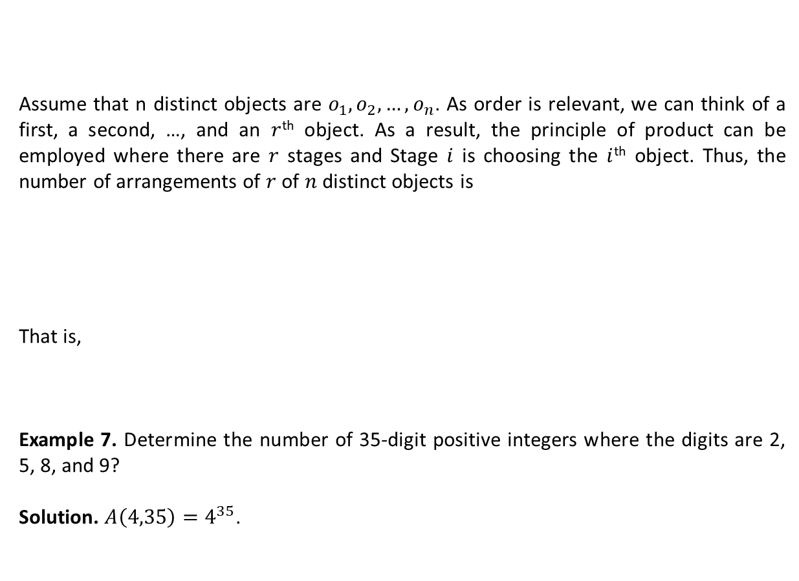
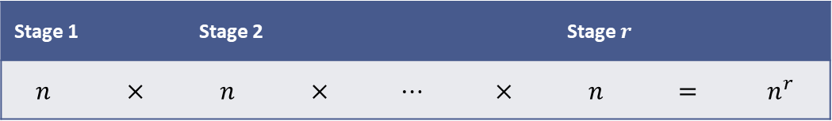
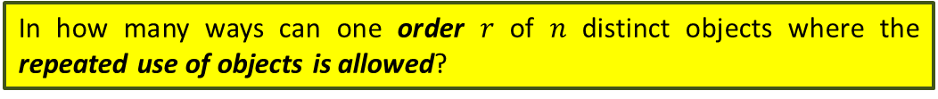
Arrangement
Assume that n distinct objects are $o_{1},o_{2},…, o_{n}$. As order is relevant, we can think of a first, a second, …, and an $r$^{th} object. As a result, the principle of product can be employed where there are $r$ stages and Stage $i$ is choosing the $i$^{th} object. Thus, the number of arrangements of $r$ of $n$ distinct objects is
That is,
Example 7. Determine the number of 35-digit positive integers where the digits are 2, 5, 8, and 9?
Solution. $A\left(4,35\right)=4^{35}$.
In how many ways can one order $r$ of $n$ distinct objects where the repeated use of objects is allowed?
Stage 1 |  | Stage 2 |  |  |  | Stage $r$
$$n$$ | $$×$$ | $$n$$ | $$×$$ | $$⋯$$ | $$×$$ | $$n$$ | $$=$$ | $$n^{r}$$
$$A\left(n,r\right)=n^{r}$$

Slide 11
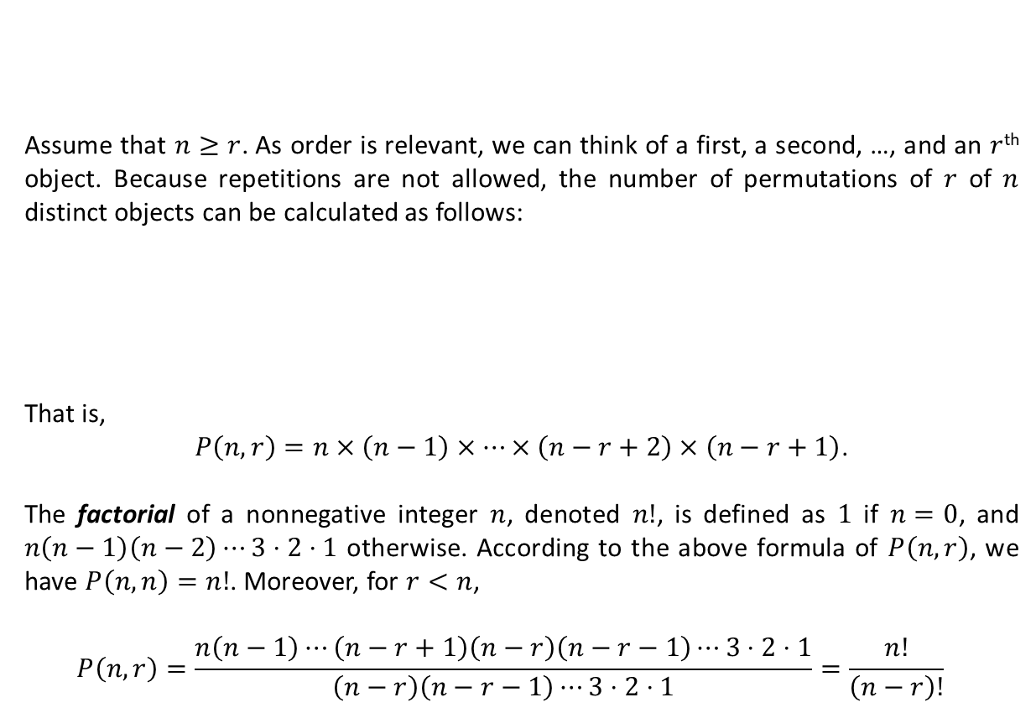
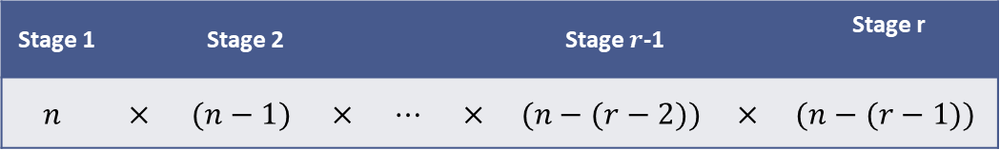
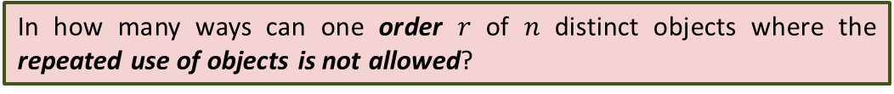
Permutation
Assume that $n≥r$. As order is relevant, we can think of a first, a second, …, and an $r$^{th} object. Because repetitions are not allowed, the number of permutations of $r$ of $n$ distinct objects can be calculated as follows:
That is,
$P\left(n,r\right)=n×\left(n−1\right)×⋯×\left(n−r+2\right)×\left(n−r+1\right)$.
The factorial of a nonnegative integer $n$, denoted $n!$, is defined as $1$ if $n=0$, and $n\left(n−1\right)\left(n−2\right)⋯3⋅2⋅1$ otherwise. According to the above formula of $P\left(n,r\right)$, we have $P\left(n,n\right)=n!$. Moreover, for $r<n$,
$$P\left(n,r\right)=\frac{n\left(n−1\right)⋯\left(n−r+1\right)\left(n−r\right)\left(n−r−1\right)⋯3⋅2⋅1}{\left(n−r\right)\left(n−r−1\right)⋯3⋅2⋅1}=\frac{n!}{\left(n−r\right)!}$$
In how many ways can one order $r$ of $n$ distinct objects where the repeated use of objects is not allowed?
Stage 1 |  | Stage 2 |  |  |  | Stage $r$-1 |  | Stage r
$$n$$ | $$×$$ | $$(n−1)$$ | $$×$$ | $$⋯$$ | $$×$$ | $$(n−(r−2))$$ | $$×$$ | $$(n−(r−1))$$

Slide 12
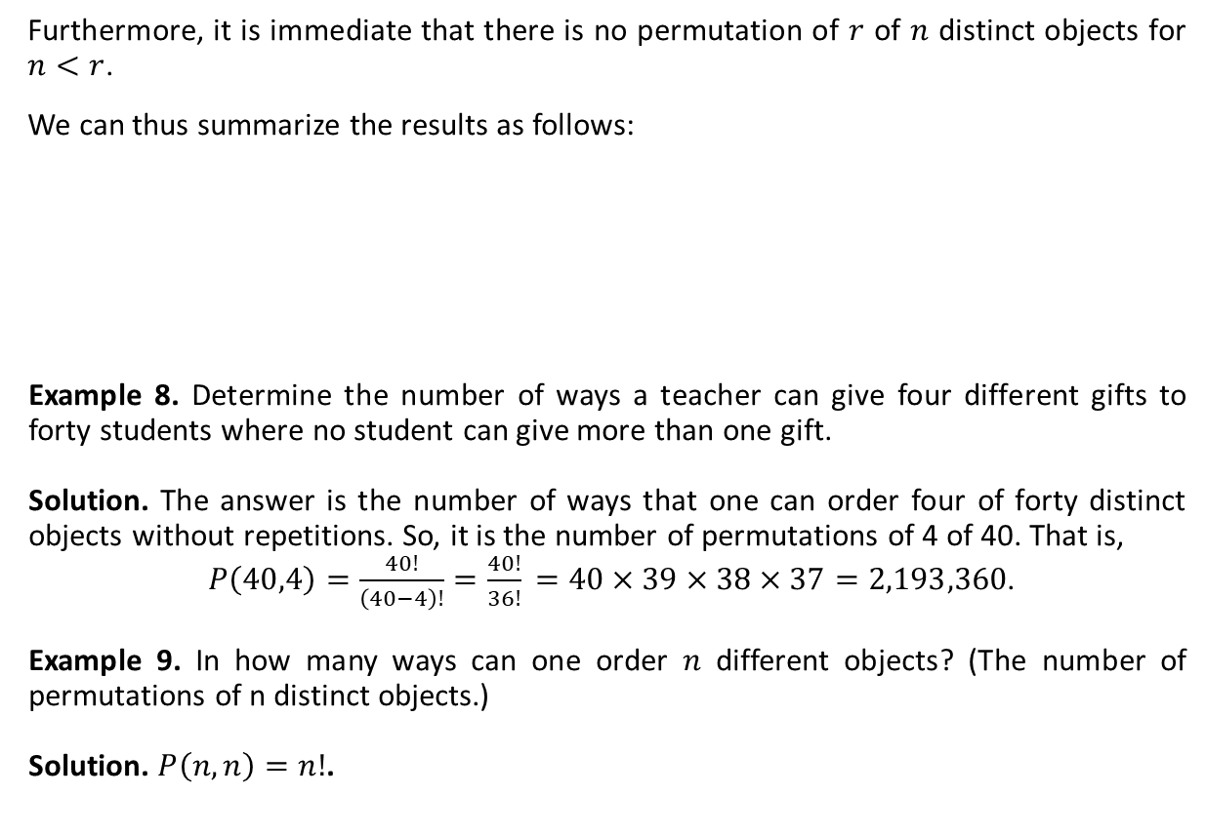
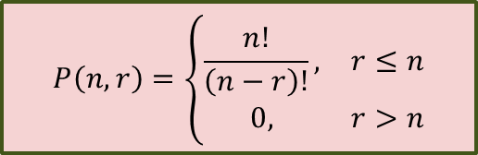
Permutation (Ctd.)
Furthermore, it is immediate that there is no permutation of $r$ of $n$ distinct objects for $n<r$.
We can thus summarize the results as follows:
Example 8. Determine the number of ways a teacher can give four different gifts to forty students where no student can give more than one gift.
Solution. The answer is the number of ways that one can order four of forty distinct objects without repetitions. So, it is the number of permutations of 4 of 40. That is,
$P\left(40,4\right)=\frac{40!}{\left(40−4\right)!}$ $=\frac{40!}{36!}$ $=40×39×38×37=2,193,360$.
Example 9. In how many ways can one order $n$ different objects? (The number of permutations of n distinct objects.)
Solution. $P\left(n,n\right)=n!$.
$$P\left(n,r\right)=\left\{\begin{matrix}\frac{n!}{\left(n−r\right)!}, & r≤n \\ 0, & r>n\end{matrix}\right.$$

Slide 13
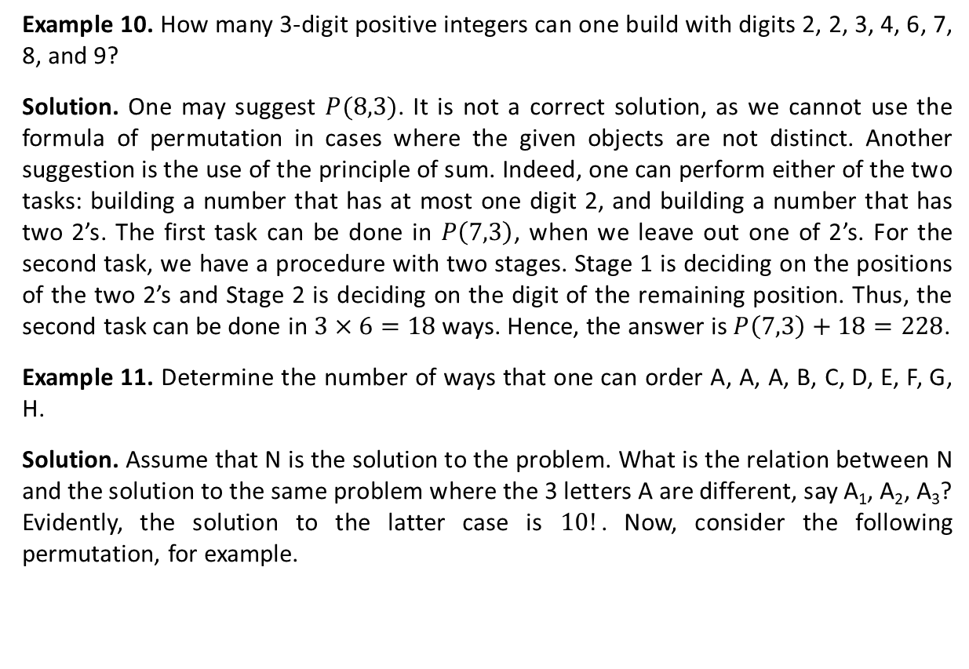
Permutation (Ctd.)
Example 10. How many 3-digit positive integers can one build with digits 2, 2, 3, 4, 6, 7, 8, and 9?
Solution. One may suggest $P(8,3)$. It is not a correct solution, as we cannot use the formula of permutation in cases where the given objects are not distinct. Another suggestion is the use of the principle of sum. Indeed, one can perform either of the two tasks: building a number that has at most one digit 2, and building a number that has two 2’s. The first task can be done in $P\left(7,3\right)$, when we leave out one of 2’s. For the second task, we have a procedure with two stages. Stage 1 is deciding on the positions of the two 2’s and Stage 2 is deciding on the digit of the remaining position. Thus, the second task can be done in $3×6=18$ ways. Hence, the answer is $P\left(7,3\right)+18=228$.
Example 11. Determine the number of ways that one can order A, A, A, B, C, D, E, F, G, H.
Solution. Assume that N is the solution to the problem. What is the relation between N and the solution to the same problem where the 3 letters A are different, say A₁, A₂, A₃? Evidently, the solution to the latter case is $10!$. Now, consider the following permutation, for example.

Slide 14
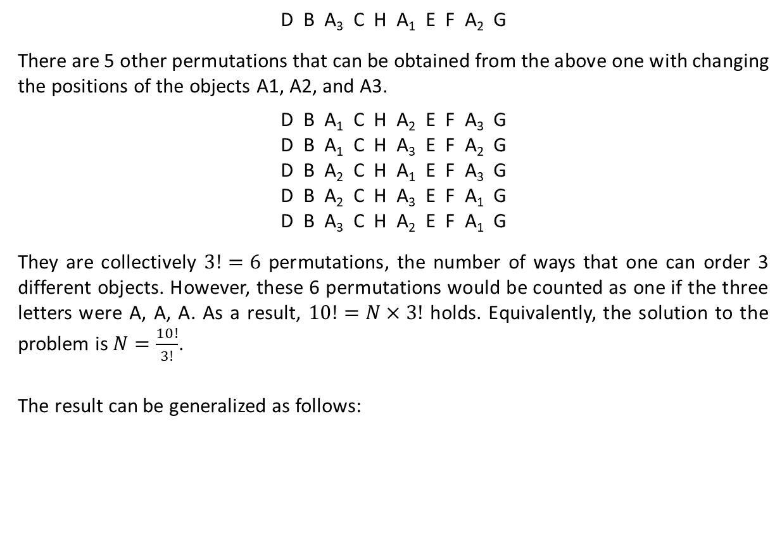
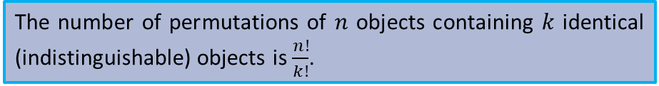
Permutation (Ctd.)
D B A₃ C H A₁ E F A₂ G
There are 5 other permutations that can be obtained from the above one with changing the positions of the objects A1, A2, and A3.
D B A₁ C H A₂ E F A₃ G
D B A₁ C H A₃ E F A₂ G
D B A₂ C H A₁ E F A₃ G
D B A₂ C H A₃ E F A₁ G
D B A₃ C H A₂ E F A₁ G
They are collectively $3!=6$ permutations, the number of ways that one can order 3 different objects. However, these 6 permutations would be counted as one if the three letters were A, A, A. As a result, $10!=N×3!$ holds. Equivalently, the solution to the problem is $N=\frac{10!}{3!}$.
The result can be generalized as follows:
The number of permutations of $n$ objects containing $k$ identical (indistinguishable) objects is $\frac{n!}{k!}$.

Slide 15

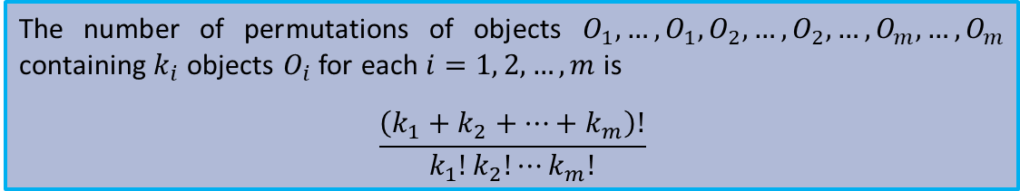
Permutation (Ctd.)
The result can even be more generalized.
Example 12. Determine the number of words that can be constructed using the letters of MISSISSIPPI (the words can be meaningless.)
Solution. There are 1 M, 4 I’s, 4 S’s, and 2 P’s. Thus, the number of permutations of the 11 letters is
$$\frac{11!}{1!4!4!2!}$$
The number of permutations of objects $O_{1}, …,O_{1},O_{2}, …,O_{2},…,O_{m}, …, O_{m}$ containing $k_{i}$ objects $O_{i}$ for each $i=1, 2,…,m$ is
$$\frac{\left(k_{1}+k_{2}+…+k_{m}\right)!}{k_{1}!k_{2}!⋯k_{m}!}$$

Slide 16
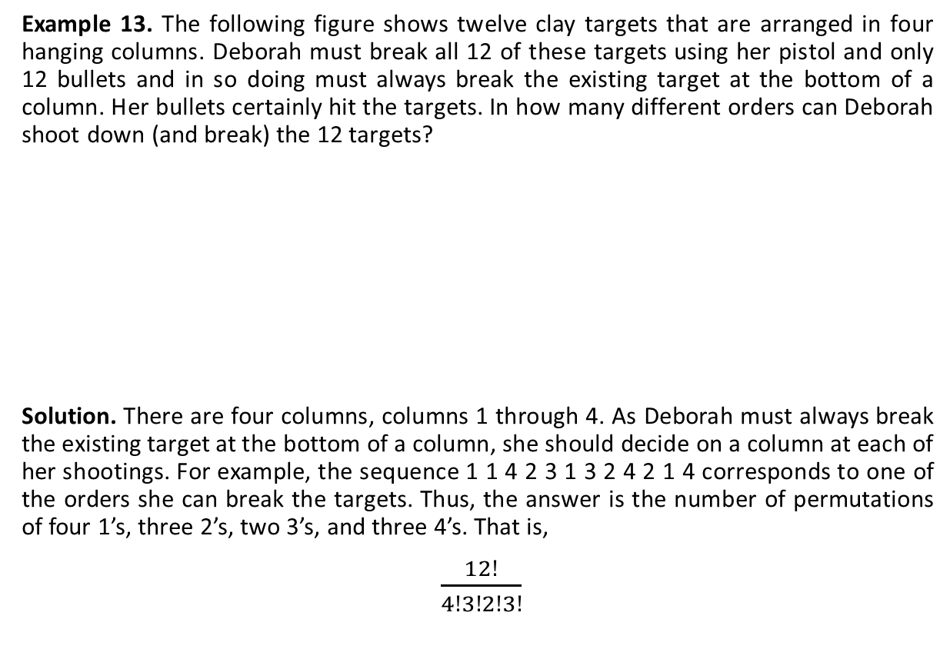
Permutation (Ctd.)
Example 13. The following figure shows twelve clay targets that are arranged in four hanging columns. Deborah must break all 12 of these targets using her pistol and only 12 bullets and in so doing must always break the existing target at the bottom of a column. Her bullets certainly hit the targets. In how many different orders can Deborah shoot down (and break) the 12 targets?
Solution. There are four columns, columns 1 through 4. As Deborah must always break the existing target at the bottom of a column, she should decide on a column at each of her shootings. For example, the sequence 1 1 4 2 3 1 3 2 4 2 1 4 corresponds to one of the orders she can break the targets. Thus, the answer is the number of permutations of four 1’s, three 2’s, two 3’s, and three 4’s. That is,
$\frac{12!}{4!3!2!3!}$

Slide 17
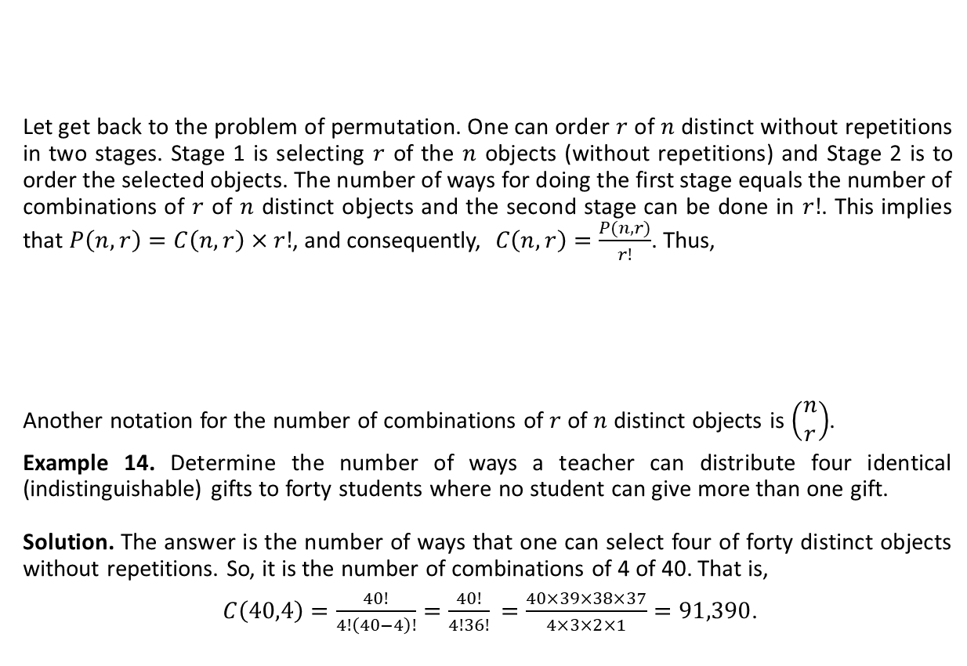
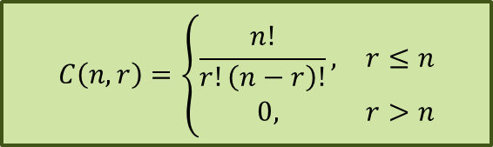
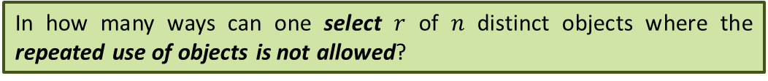
Combination
Let get back to the problem of permutation. One can order $r$ of $n$ distinct without repetitions in two stages. Stage 1 is selecting $r$ of the $n$ objects (without repetitions) and Stage 2 is to order the selected objects. The number of ways for doing the first stage equals the number of combinations of $r$ of $n$ distinct objects and the second stage can be done in $r!$. This implies that $P\left(n,r\right)=C\left(n,r\right)×r!$, and consequently, $C\left(n,r\right)=\frac{P(n,r)}{r!}$. Thus,
Another notation for the number of combinations of $r$ of $n$ distinct objects is $\left(\begin{matrix}n \\ r\end{matrix}\right)$.
Example 14. Determine the number of ways a teacher can distribute four identical (indistinguishable) gifts to forty students where no student can give more than one gift.
Solution. The answer is the number of ways that one can select four of forty distinct objects without repetitions. So, it is the number of combinations of 4 of 40. That is,
$C\left(40,4\right)=\frac{40!}{4!\left(40−4\right)!}$ $=\frac{40!}{4!36!}$ $=\frac{40×39×38×37}{4×3×2×1}=91,390$.
In how many ways can one select $r$ of $n$ distinct objects where the repeated use of objects is not allowed?
$$C\left(n,r\right)=\left\{\begin{matrix}\frac{n!}{r!\left(n−r\right)!}, & r≤n \\ 0, & r>n\end{matrix}\right.$$

Slide 18
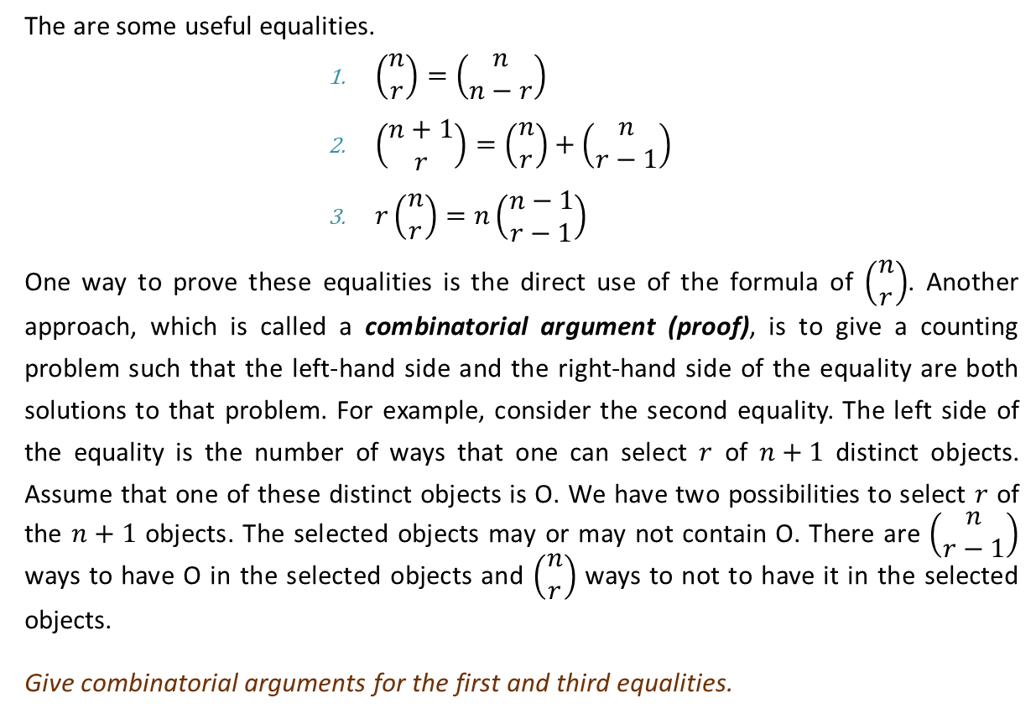
Combination (Ctd.)
The are some useful equalities.
$\left(\begin{matrix}n \\ r\end{matrix}\right)=\left(\begin{matrix}n \\ n−r\end{matrix}\right)$
$\left(\begin{matrix}n+1 \\ r\end{matrix}\right)=\left(\begin{matrix}n \\ r\end{matrix}\right)+\left(\begin{matrix}n \\ r−1\end{matrix}\right)$
$r\left(\begin{matrix}n \\ r\end{matrix}\right)=n\left(\begin{matrix}n−1 \\ r−1\end{matrix}\right)$
One way to prove these equalities is the direct use of the formula of $\left(\begin{matrix}n \\ r\end{matrix}\right)$. Another approach, which is called a combinatorial argument (proof), is to give a counting problem such that the left-hand side and the right-hand side of the equality are both solutions to that problem. For example, consider the second equality. The left side of the equality is the number of ways that one can select $r$ of $n+1$ distinct objects. Assume that one of these distinct objects is O. We have two possibilities to select $r$ of the $n+1$ objects. The selected objects may or may not contain O. There are $\left(\begin{matrix}n \\ r−1\end{matrix}\right)$ ways to have O in the selected objects and $\left(\begin{matrix}n \\ r\end{matrix}\right)$ ways to not to have it in the selected objects.
Give combinatorial arguments for the first and third equalities.

Slide 19
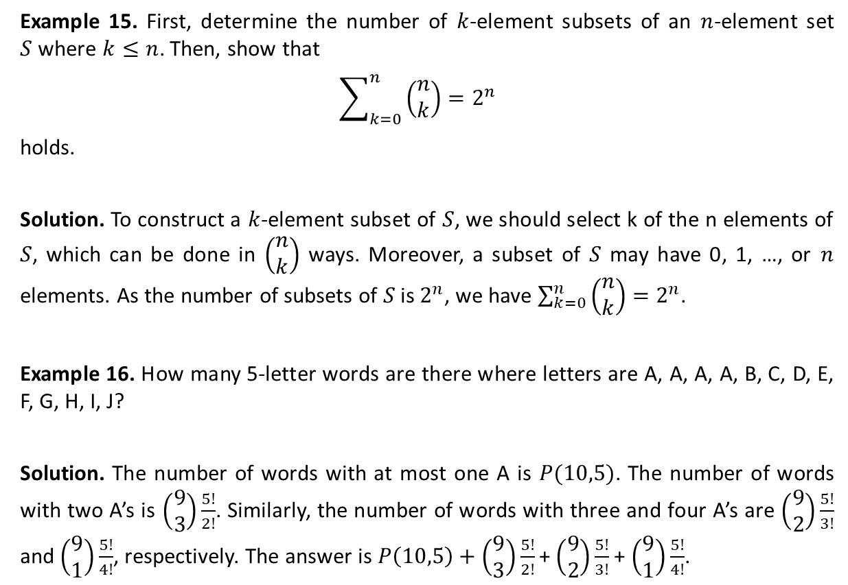
Combination (Ctd.)
Example 15. First, determine the number of $k$-element subsets of an $n$-element set $S$where $k≤n$. Then, show that
$$\sum_{k=0}^{n}{\left(\begin{matrix}n \\ k\end{matrix}\right)}=2^{n}$$
holds.
Solution. To construct a $k$-element subset of $S$, we should select k of the n elements of $S$, which can be done in $\left(\begin{matrix}n \\ k\end{matrix}\right)$ ways. Moreover, a subset of $S$ may have 0, 1, …, or $n$ elements. As the number of subsets of $S$ is $2^{n}$, we have $\sum_{k=0}^{n}{\left(\begin{matrix}n \\ k\end{matrix}\right)}=2^{n}$.
Example 16. How many 5-letter words are there where letters are A, A, A, A, B, C, D, E, F, G, H, I, J?
Solution. The number of words with at most one A is $P(10,5)$. The number of words with two A’s is $\left(\begin{aligned}9 \\ 3\end{aligned}\right)\frac{5!}{2!}$. Similarly, the number of words with three and four A’s are $\left(\begin{aligned}9 \\ 2\end{aligned}\right)\frac{5!}{3!}$ and $\left(\begin{aligned}9 \\ 1\end{aligned}\right)\frac{5!}{4!}$, respectively. The answer is$P\left(10,5\right)+\left(\begin{aligned}9 \\ 3\end{aligned}\right)\frac{5!}{2!}$ + $\left(\begin{aligned}9 \\ 2\end{aligned}\right)\frac{5!}{3!}$ + $\left(\begin{aligned}9 \\ 1\end{aligned}\right)\frac{5!}{4!}$.

Slide 20
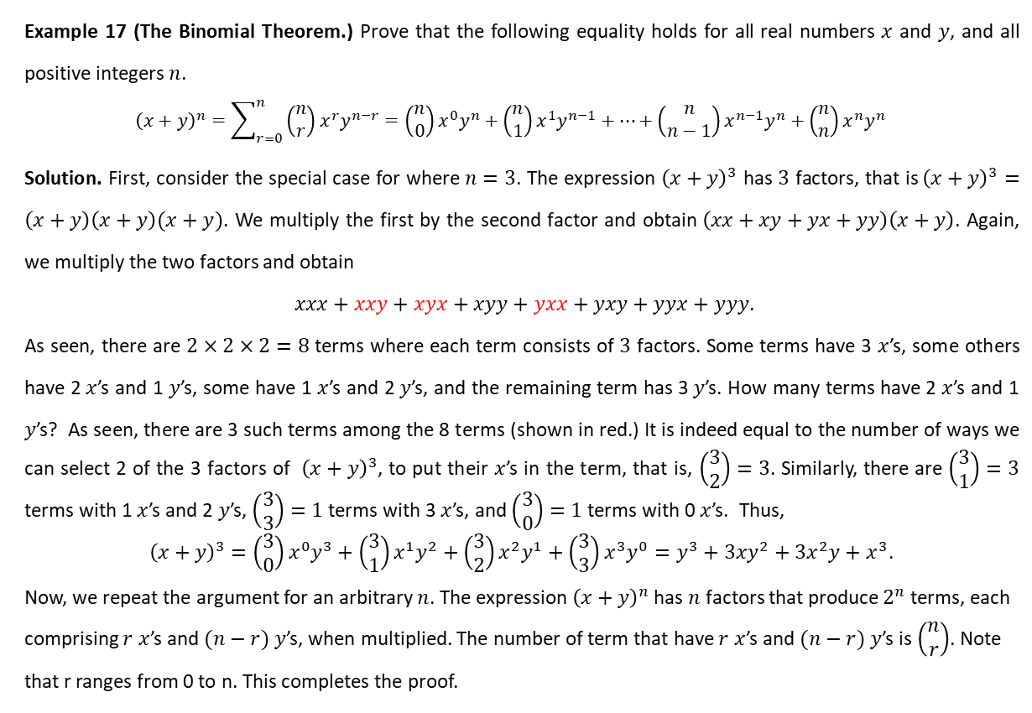
Combination (Ctd.)
Example 17 (The Binomial Theorem.) Prove that the following equality holds for all real numbers $x$ and $y$, and all positive integers $n$.
$${\left(x+y\right)}^{n}=\sum_{r=0}^{n}{\left(\begin{matrix}n \\ r\end{matrix}\right)x^{r}y^{n−r}}=\left(\begin{matrix}n \\ 0\end{matrix}\right)x^{0}y^{n}+\left(\begin{matrix}n \\ 1\end{matrix}\right)x^{1}y^{n−1}+⋯+\left(\begin{matrix}n \\ n−1\end{matrix}\right)x^{n−1}y^{n}+\left(\begin{matrix}n \\ n\end{matrix}\right)x^{n}y^{n}$$
Solution. First, consider the special case for where $n=3$. The expression ${\left(x+y\right)}^{3}$ has $3$ factors, that is${\left(x+y\right)}^{3}=\left(x+y\right)\left(x+y\right)(x+y)$. We multiply the first by the second factor and obtain $\left(xx+xy+yx+yy\right)\left(x+y\right)$. Again, we multiply the two factors and obtain
$xxx+xxy+xyx+xyy+yxx+yxy+yyx+yyy$.
As seen, there are $2×2×2=8$ terms where each term consists of $3$ factors. Some terms have 3 $x$’s, some others have 2 $x$’s and 1 $y$’s, some have 1 $x$’s and 2 $y$’s, and the remaining term has 3 $y$’s. How many terms have 2 $x$’s and 1 $y$’s? As seen, there are 3 such terms among the 8 terms (shown in red.) It is indeed equal to the number of ways we can select 2 of the 3 factors of ${\left(x+y\right)}^{3}$, to put their $x$’s in the term, that is, $\left(\begin{matrix}3 \\ 2\end{matrix}\right)=3$. Similarly, there are $\left(\begin{matrix}3 \\ 1\end{matrix}\right)=3$ terms with 1 $x$’s and 2 $y$’s, $\left(\begin{matrix}3 \\ 3\end{matrix}\right)=1$ terms with 3 $x$’s, and $\left(\begin{matrix}3 \\ 0\end{matrix}\right)=1$ terms with 0 $x$’s. Thus,
${\left(x+y\right)}^{3}=\left(\begin{matrix}3 \\ 0\end{matrix}\right)x^{0}y^{3}+\left(\begin{matrix}3 \\ 1\end{matrix}\right)x^{1}y^{2}+\left(\begin{matrix}3 \\ 2\end{matrix}\right)x^{2}y^{1}+\left(\begin{matrix}3 \\ 3\end{matrix}\right)x^{3}y^{0}=y^{3}+3xy^{2}+3x^{2}y+x^{3}$.
Now, we repeat the argument for an arbitrary $n$. The expression ${\left(x+y\right)}^{n}$ has $n$ factors that produce $2^{n}$ terms, each comprising $r$ $x$’s and $(n−r)$ $y$’s, when multiplied. The number of term that have $r$ $x$’s and $(n−r)$ $y$’s is $\left(\begin{matrix}n \\ r\end{matrix}\right)$. Note that r ranges from 0 to n. This completes the proof.

Slide 21
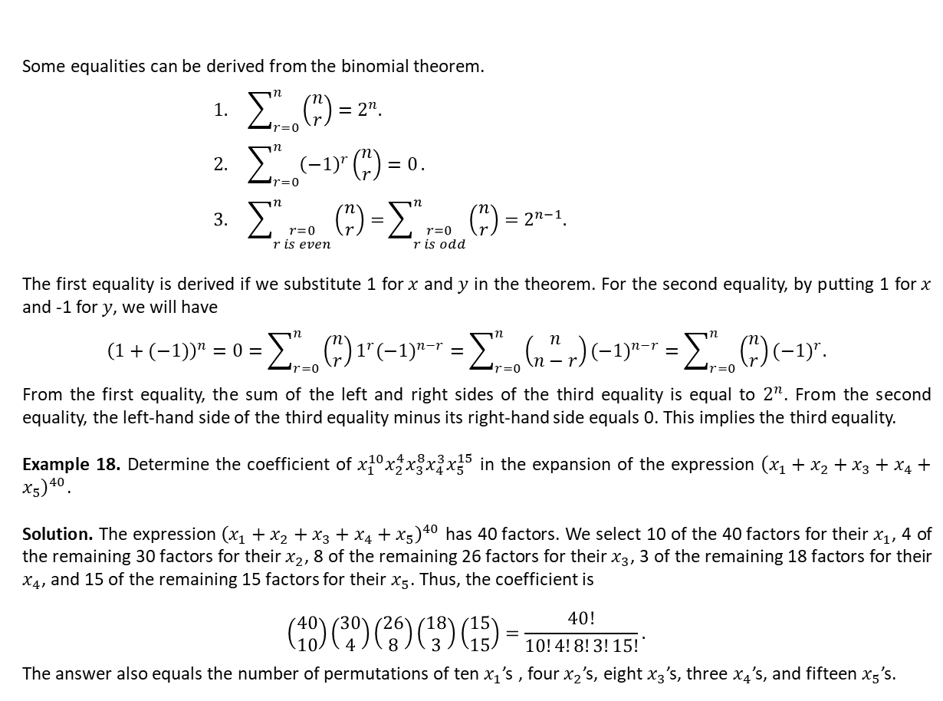
Combination (Ctd.)
Some equalities can be derived from the binomial theorem.
$$1. \sum_{r=0}^{n}{\left(\begin{aligned}n \\ r\end{aligned}\right)=2^{n}.}$$
$$2. \sum_{r=0}^{n}{{\left(−1\right)}^{r}\left(\begin{aligned}n \\ r\end{aligned}\right)=0}.$$
$$3. \sum_{\begin{aligned}r=0 \\ r is even\end{aligned}}^{n}{\left(\begin{aligned}n \\ r\end{aligned}\right)=}\sum_{\begin{aligned}r=0 \\ r is odd\end{aligned}}^{n}{\left(\begin{aligned}n \\ r\end{aligned}\right)}=2^{n−1}.$$
The first equality is derived if we substitute 1 for $x$ and $y$ in the theorem. For the second equality, by putting 1 for $x$ and -1 for $y$, we will have
$${\left(1+(−1)\right)}^{n}=0=\sum_{r=0}^{n}{\left(\begin{matrix}n \\ r\end{matrix}\right)1^{r}{(−1)}^{n−r}}=\sum_{r=0}^{n}{\left(\begin{matrix}n \\ n−r\end{matrix}\right){(−1)}^{n−r}}=\sum_{r=0}^{n}{\left(\begin{matrix}n \\ r\end{matrix}\right){(−1)}^{r}.}$$
From the first equality, the sum of the left and right sides of the third equality is equal to $2^{n}$. From the second equality, the left-hand side of the third equality minus its right-hand side equals 0. This implies the third equality.
Example 18. Determine the coefficient of $x_{1}^{10}x_{2}^{4}x_{3}^{8}x_{4}^{3}x_{5}^{15}$ in the expansion of the expression ${\left(x_{1}+x_{2}+x_{3}+x_{4}+x_{5}\right)}^{40}$.
Solution. The expression ${\left(x_{1}+x_{2}+x_{3}+x_{4}+x_{5}\right)}^{40}$ has 40 factors. We select 10 of the 40 factors for their $x_{1}$, 4 of the remaining 30 factors for their $x_{2}$, 8 of the remaining 26 factors for their $x_{3}$, 3 of the remaining 18 factors for their $x_{4}$, and 15 of the remaining 15 factors for their $x_{5}$. Thus, the coefficient is
$$\left(\begin{matrix}40 \\ 10\end{matrix}\right)\left(\begin{matrix}30 \\ 4\end{matrix}\right)\left(\begin{matrix}26 \\ 8\end{matrix}\right)\left(\begin{matrix}18 \\ 3\end{matrix}\right)\left(\begin{matrix}15 \\ 15\end{matrix}\right)=\frac{40!}{10!4!8!3!15!}.$$
The answer also equals the number of permutations of ten $x_{1}$’s , four $x_{2}$’s, eight $x_{3}$’s, three $x_{4}$’s, and fifteen $x_{5}$’s.

Slide 22
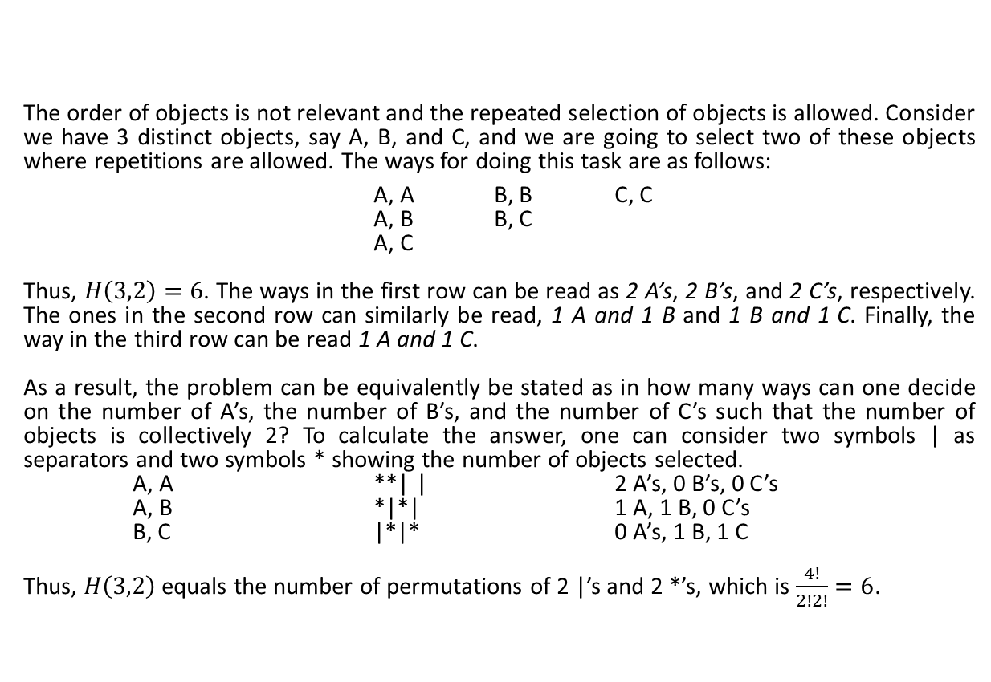
Combination with Repetition
The order of objects is not relevant and the repeated selection of objects is allowed. Consider we have 3 distinct objects, say A, B, and C, and we are going to select two of these objects where repetitions are allowed. The ways for doing this task are as follows:
A, A B, B C, C
A, B B, C
A, C
Thus, $H\left(3,2\right)=6$. The ways in the first row can be read as 2 A’s, 2 B’s, and 2 C’s, respectively. The ones in the second row can similarly be read, 1 A and 1 B and 1 B and 1 C. Finally, the way in the third row can be read 1 A and 1 C.
As a result, the problem can be equivalently be stated as in how many ways can one decide on the number of A’s, the number of B’s, and the number of C’s such that the number of objects is collectively 2? To calculate the answer, one can consider two symbols | as separators and two symbols * showing the number of objects selected.
A, A **| | 2 A’s, 0 B’s, 0 C’s
A, B *|*| 1 A, 1 B, 0 C’s
B, C |*|* 0 A’s, 1 B, 1 C
Thus, $H\left(3,2\right)$ equals the number of permutations of 2 |’s and 2 *’s, which is $\frac{4!}{2!2!}=6$.
In how many ways can one select $r$ of $n$ distinct objects where the repeated use of objects is allowed?

Slide 23
Combination with Repetition (Ctd.)
The argument can be generalized to the problem of combination with repetition of $r$ of $n$ distinct objects: $H(n,r)$ equals the number of permutations of $n−1$ |’s and $r$ *’s, that is, $H\left(n,r\right)=\frac{\left(\left(n−1\right)+r\right)!}{\left(n−1\right)!r!}=\frac{\left(n+r−1\right)!}{r!\left(n−1\right)!}$. Therefore,
Example 19. Determine the number of ways in which a teacher can distribute 8 identical gifts among 40 students.
Solution. This is equivalent to selecting 8 of 40 distinct objects where the repeated use of objects is allowed. That is, the answer is
$$H\left(40,8\right)=\left(\begin{matrix}40+8−1 \\ 40\end{matrix}\right)=\left(\begin{matrix}47 \\ 40\end{matrix}\right)$$
Example 20. Find the number of nonnegative solutions to the equation
$x_{1}+x_{2}+…x_{k}=n$.
Solution. The answer is the number of ways that one can select $n$ objects of $k$ objects $x_{1}, x_{2}, …, x_{k}$where the repeated use of objects is allowed, that is,
$$\left(\begin{matrix}k+n−1 \\ n\end{matrix}\right)=\left(\begin{matrix}n+k−1 \\ k−1\end{matrix}\right).$$
$$H\left(n,r\right)=\left(\begin{matrix}n+r−1 \\ r\end{matrix}\right)=\left(\begin{matrix}n+r−1 \\ n−1\end{matrix}\right)$$

Slide 24
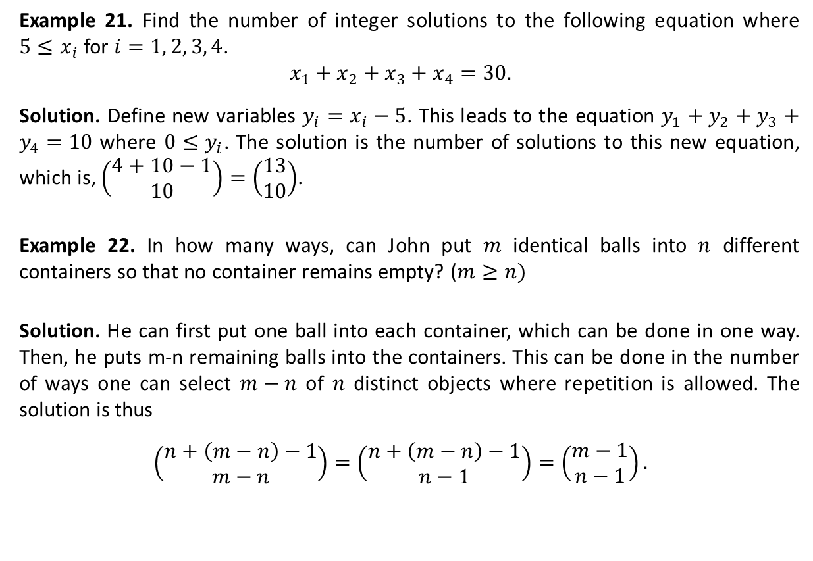
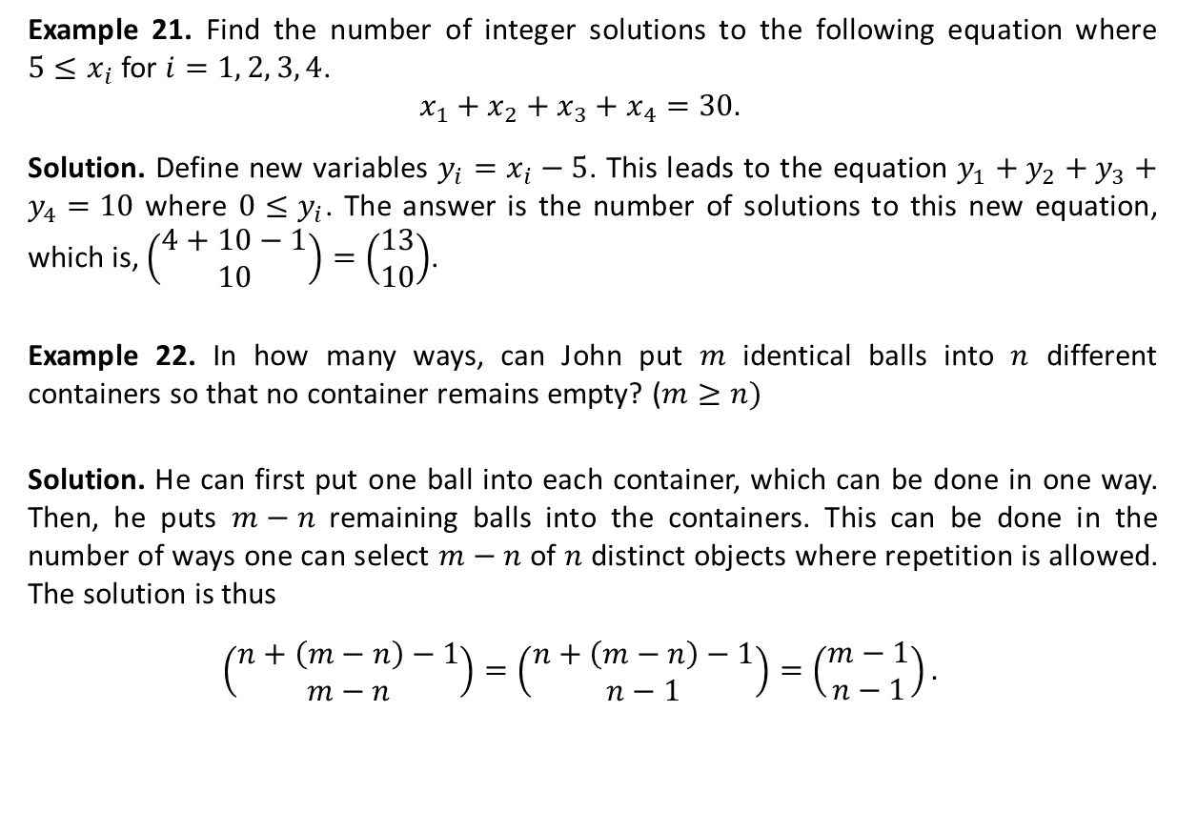
Combination with Repetition (Ctd.)
Example 21. Find the number of integer solutions to the following equation where $5≤x_{i}$ for $i=1, 2, 3, 4$.
$$x_{1}+x_{2}+x_{3}+x_{4}=30.$$
Solution. Define new variables $y_{i}=x_{i}−5$. This leads to the equation $y_{1}+y_{2}+y_{3}+y_{4}=10$ where $0≤y_{i}$. The answer is the number of solutions to this new equation, which is, $\left(\begin{matrix}4+10−1 \\ 10\end{matrix}\right)=\left(\begin{matrix}13 \\ 10\end{matrix}\right)$.
Example 22. In how many ways, can John put $m$ identical balls into $n$ different containers so that no container remains empty? ($m≥n)$
Solution. He can first put one ball into each container, which can be done in one way. Then, he puts $m−n$ remaining balls into the containers. This can be done in the number of ways one can select $m−n$ of $n$ distinct objects where repetition is allowed. The solution is thus
$$\left(\begin{matrix}n+\left(m−n\right)−1 \\ m−n\end{matrix}\right)=\left(\begin{matrix}n+\left(m−n\right)−1 \\ n−1\end{matrix}\right)=\left(\begin{matrix}m−1 \\ n−1\end{matrix}\right).$$

Slide 25
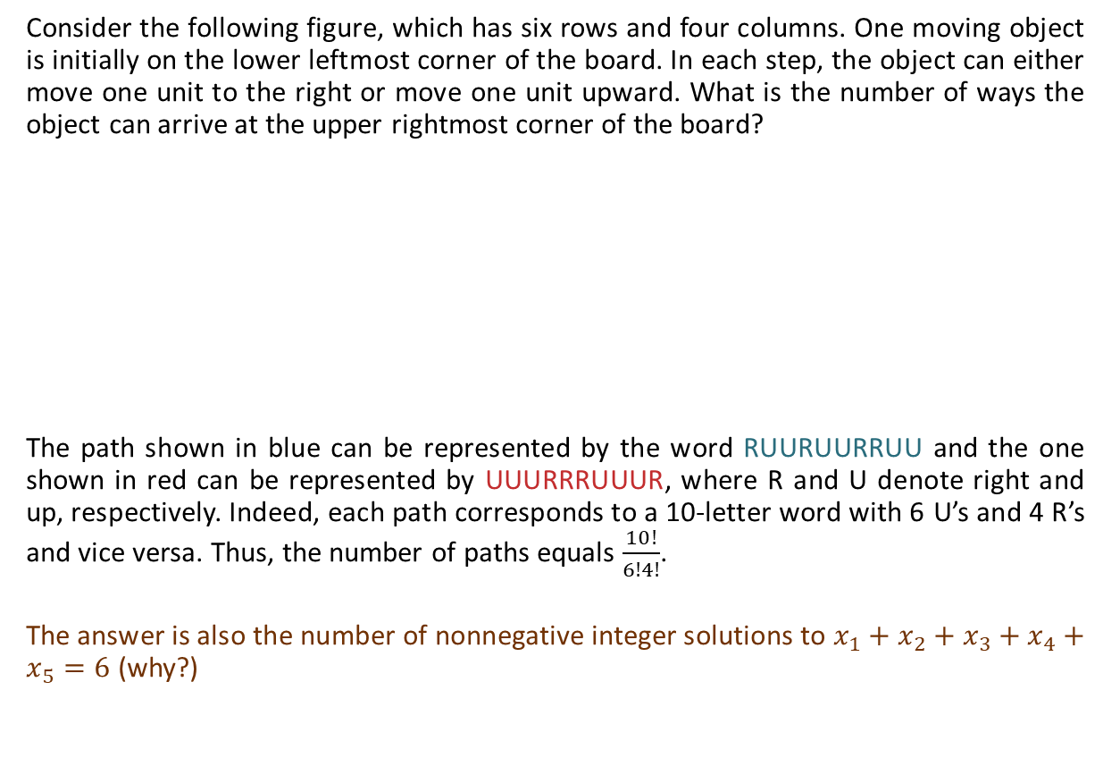
The Catalan Number
Consider the following figure, which has six rows and four columns. One moving object is initially on the lower leftmost corner of the board. In each step, the object can either move one unit to the right or move one unit upward. What is the number of ways the object can arrive at the upper rightmost corner of the board?
The path shown in blue can be represented by the word RUURUURRUU and the one shown in red can be represented by UUURRRUUUR, where R and U denote right and up, respectively. Indeed, each path corresponds to a 10-letter word with 6 U’s and 4 R’s and vice versa. Thus, the number of paths equals $\frac{10!}{6!4!}$.
The answer is also the number of nonnegative integer solutions to $x_{1}+x_{2}+x_{3}+x_{4}+x_{5}=6$ (why?)

Slide 26
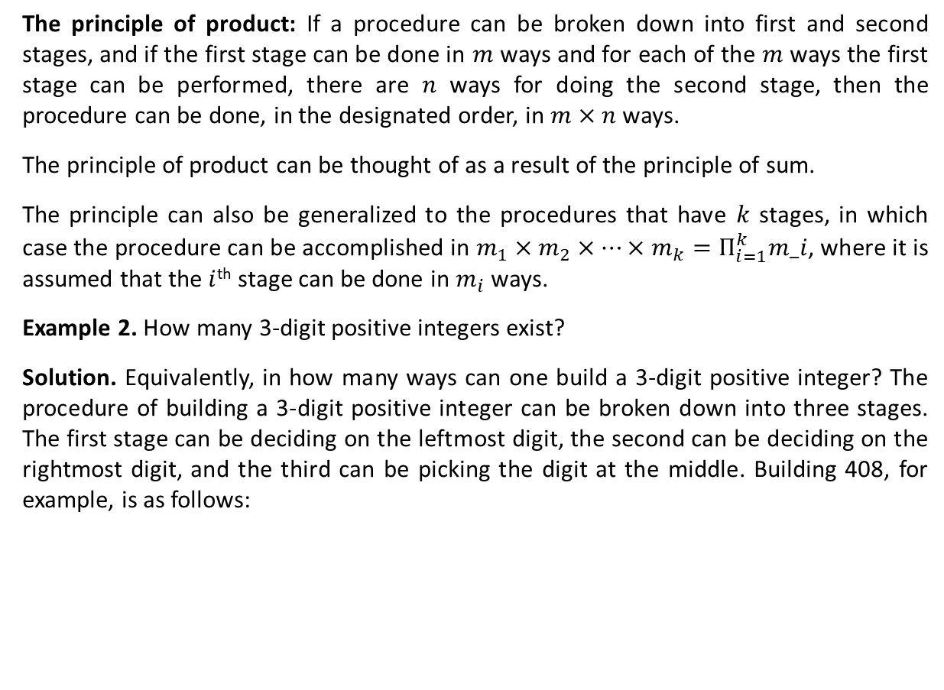
The Catalan Number (Ctd.)
Consider the following figure. Each move is one of the types U: $\left(x,y\right)⟶(x+1,y+1)$ and D: $\left(x,y\right)⟶(x+1,y−1)$. In how many ways can one travel in the $xy$-plane from (0,2) to (22,4), that is, from A to B?
As with the previous example, any path from $A$ to $B$ corresponds to a permutation of 12 U’s and 10 D’s. Therefore, the number of paths from $A$ to $B$ is $N_{AB}=\frac{22!}{12!10!}=3,628,800$.
Can you find the number of paths from $A$ to $B$ that touch or cross the $x$-axis?
Consider the brown path in the figure, it corresponds to the dashed brown path, which is the result of reflecting the segment of the brown path from $A$ to the first point it reaches (touches or crosses) the $x$-axis. The same holds for the red path. Thus, the number of paths from $A$ to $B$ that touch or cross the $x$-axis is equal to the number of paths from $A′$ to $B$ where $A′$ is the result of reflecting $A$ in the $x$-axis, that is, $N_{A^{′}B}=\frac{22!}{14!8!}=319,770$.
y
B (22,4)
A (0,2)
x
A’ (0,-2)

Slide 27
The Catalan Number (Ctd.)
y
Can you find the number of paths from $A$ to $B$ that cross the $x$-axis?
Such paths touch or cross the line $y=−1$. So, we can reflect A in line y=-1, which results in the point A’’(0,-4). The number of paths from A to B that cross the x-axis is thus the number of paths from A’’ to B, that is, $N_{A^{′′}B}=\frac{22!}{15!7!}=170,544$.
B (22,4)
A (0,2)
x
$$y=−1$$
A’’(0,-4)

Slide 28
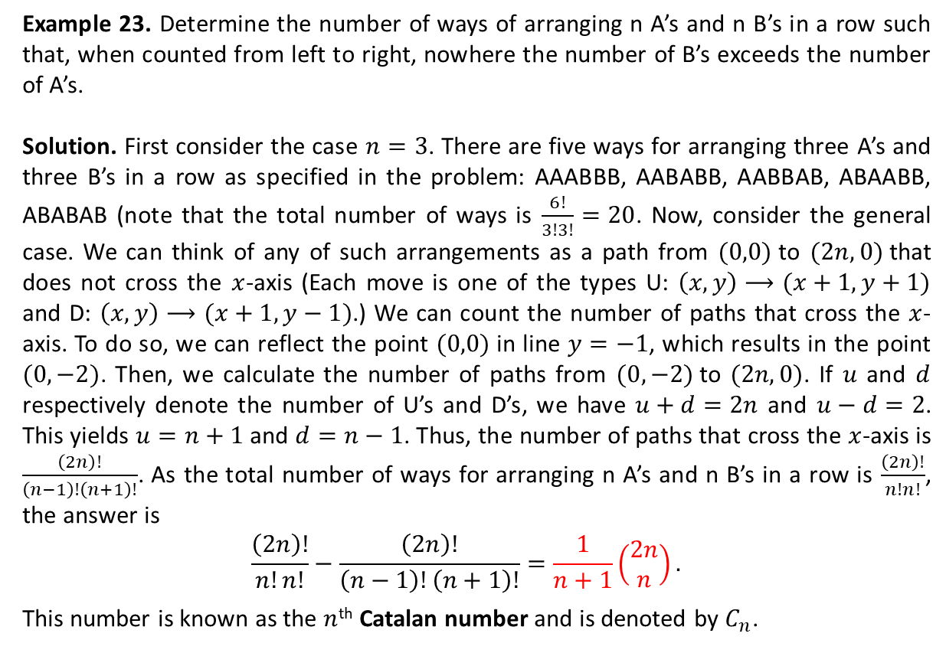
The Catalan Number (Ctd.)
Y
B
Example 23. Determine the number of ways of arranging n A’s and n B’s in a row such that, when counted from left to right, nowhere the number of B’s exceeds the number of A’s.
Solution. First consider the case $n=3$. There are five ways for arranging three A’s and three B’s in a row as specified in the problem: AAABBB, AABABB, AABBAB, ABAABB, ABABAB (note that the total number of ways is $\frac{6!}{3!3!}=20$. Now, consider the general case. We can think of any of such arrangements as a path from $(0,0)$to $(2n,0)$that does not cross the $x$-axis (Each move is one of the types U: $\left(x,y\right)⟶(x+1,y+1)$ and D: $\left(x,y\right)⟶(x+1,y−1)$.) We can count the number of paths that cross the $x$-axis. To do so, we can reflect the point $(0,0)$in line $y=−1$, which results in the point $(0,−2)$. Then, we calculate the number of paths from $(0,−2)$to $(2n,0)$. If $u$ and $d$ respectively denote the number of U’s and D’s, we have $u+d=2n$ and $u−d=2$. This yields $u=n+1$ and $d=n−1$. Thus, the number of paths that cross the $x$-axis is $\frac{\left(2n\right)!}{\left(n−1\right)!\left(n+1\right)!}$. As the total number of ways for arranging n A’s and n B’s in a row is $\frac{\left(2n\right)!}{n!n!}$, the answer is
$$\frac{\left(2n\right)!}{n!n!}−\frac{\left(2n\right)!}{\left(n−1\right)!\left(n+1\right)!}=\frac{1}{n+1}\left(\begin{matrix}2n \\ n\end{matrix}\right).$$
This number is known as the $n$^{th} Catalan number and is denoted by $C_{n}$.
A
B
A
B
B
A
B
A
X
A
B
A

Slide 29
Textbook: Ralph P. Grimaldi, Discrete and Combinatorial Mathematics
Do exercises of Chapter 1 as homework and upload your solutions via Moodle (follow the instructions on the page of the TA course.)

